Slide 1
Low Level Network Attacks
CS 161 Fall 2022 - Lecture 17

Slide 2
Last Time: Intro to Networking
Internet: A global network of computers
Protocols: Agreed-upon systems of communication
OSI model: A layered model of protocols
Layer 1: Communication of bits
Layer 2: Local frame delivery
Ethernet: The most common Layer 2 protocol
MAC addresses: 6-byte addressing system used by Ethernet
Layer 3: Global packet delivery
IP: The universal Layer 3 protocol
IP addresses: 4-byte (or 16-byte) addressing system used by IP
Layer 4: Transport of data (more on this next time)
Layer 7: Applications and services (the web)
7
Application
4
Transport
3
(Inter) Network
2
Link
1
Physical

Slide 3
Last Time: ARP
Classes of attackers:
Off-path: Can’t see, modify, or drop packets
On-path: Can see packets, but can’t modify or drop packets
MITM: Can see, modify, and drop packets
ARP: A protocol to translate local IP addresses to MAC addresses
Ask everyone on the network, “Who has the IP 1.2.3.4?”
Attack: The attacker can respond instead of the true device with 1.2.3.4, and packets will get routed to the attacker!
Defense: Switches
Defense: Rely on higher layers

Slide 4
Today: Low-Level Network Attacks
WPA: Communicate securely in a wireless local network
DHCP: Get configurations when first connecting to a network

Slide 5
Dynamic Host Configuration Protocol (DHCP)

Slide 6
DHCP: Initial Network Configuration
To connect to a network, a user needs:
An IP address so that other people can contact the user
The IP address of the DNS server (we’ll see this soon)
The IP address of the router (gateway) so that the user can contact machines outside of the LAN
The first time a user connects, they don’t have this information yet
The user also doesn’t know who to ask for this information
DHCP gives the user a configuration when they first join the network

Slide 7
Steps of the DHCP Handshake
Client Discover: The client broadcasts a request for a configuration
DHCP Offer: Any DHCP server can respond with a configuration offer
Usually only one DHCP server responds
The offer includes an IP address for the client, the DNS server’s IP address, and the (gateway) router’s IP address
The offer also has an expiration time (how long the user can use this configuration)
Client Request: The client broadcasts which configuration it has chosen
If multiple DHCP servers made offers, the ones that were not chosen discard their offer
The chosen DHCP server gives the offer to the client
DHCP Acknowledgement: The chosen server confirms that its configuration has been given to the client

Slide 8
Dynamic Host Configuration Protocol (DHCP)
Bob
DHCP Server 1
Alice’s configuration
My IP | ???
DNS Server | ???
Gateway | ???
Alice
DHCP Server 2
Router
Alice wants to connect to the network, but she’s missing a configuration.

Slide 9
Dynamic Host Configuration Protocol (DHCP)
Bob
“Can anyone give me a configuration?”
DHCP Server 1
Alice’s configuration
My IP | ???
DNS Server | ???
Gateway | ???
Alice
DHCP Server 2
Router
1. Client Discover: Alice broadcasts a request for a configuration.

Slide 10
Dynamic Host Configuration Protocol (DHCP)
Bob
“You can use IP x, DNS server y, and gateway z”
DHCP Server
Alice’s configuration
My IP | ???
DNS Server | ???
Gateway | ???
Alice
“You can use IP a, DNS server b, and gateway c”
DHCP Server
Router
2. DHCP Offer: Any DHCP server can reply with an offer for Alice.

Slide 11
Dynamic Host Configuration Protocol (DHCP)
Bob
“I’ll use DHCP Server 1”
DHCP Server 1
Alice’s configuration
My IP | ???
DNS Server | ???
Gateway | ???
Alice
DHCP Server 2
Router
3. Client Request: Alice broadcasts which configuration she has chosen.

Slide 12
Dynamic Host Configuration Protocol (DHCP)
Bob
Reserved for Alice: IP x, DNS y, gateway z
DHCP Server 1
Alice’s configuration
My IP | x
DNS Server | y
Gateway | z
Alice
DHCP Server 2
Router
4. DHCP Acknowledgement: The chosen DHCP server confirms that the configuration has been set for Alice.

Slide 13
DHCP Attacks
Alice has no way of verifying the DHCP response
Spoofing: Any attacker on the network can claim to have a configuration
Alice usually expects only one DHCP server to respond, so she will accept the first response
Race condition: As long as the attacker responds faster, Alice will accept the attacker’s response
DHCP attacks require Mallory to be in the same LAN as Alice
DHCP attacks let Mallory become a man-in-the-middle (MITM) attacker
Mallory claims the gateway router’s address is Mallory’s address
When Alice sends a message to the rest of the Internet, she actually sends it to Mallory
Mallory can modify the message before sending it to its destination
Mallory can also claim the DNS server’s address is Mallory’s address

Slide 14
ARP and DHCP
The attacks on ARP and DHCP are very similar
Spoofing: The attacker claims to have an answer
Race condition: The requester accepts the first response. As long as the attacker’s response arrives first, it is accepted
Main vulnerabilities
Broadcast protocols: Requests are sent to everyone on the LAN, so the attacker can see every request
No trust anchor: There is no way to verify that responses are legitimate

Slide 15
DHCP Defenses
DHCP is hard to defend against
No root of trust: When we first connect, there’s nobody we can trust
Instead, we rely on defenses provided in higher layers

Slide 16
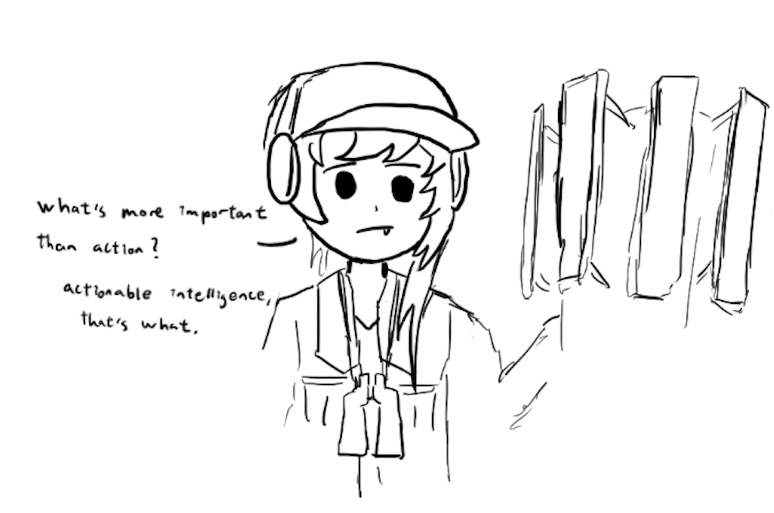
Wireless Local Networks

Slide 17
Wi-Fi
Wi-Fi: A layer 2 protocol that wirelessly connects machines in a LAN
Alternative is Ethernet, which uses wires to connect machines in a LAN
Parts of a Wi-Fi network
Access point: A machine that will help you connect to the network
SSID (service set identifier): The name of the Wi-Fi network
Password: Optionally, a password to secure Wi-Fi communications

Slide 18
WPA2
Wi-Fi Protected Access 2 (WPA2): A protocol for securing Wi-Fi network communications with cryptography
Design goals
Everyone with the Wi-Fi password can join the network
Messages sent over the network are encrypted with keys
An attacker who does not know the Wi-Fi network cannot learn the keys

Slide 19
WPA Handshake
Client
Access Point
Authentication Request
Derive PSK from wifi password
Derive PSK from wifi password
The client sends an authentication request to the access point
ANonce
Both use the password to derive the PSK (pre-shared key)
SNonce
Both exchange random nonces
Both use the PSK, nonces, and MAC addresses to derive the PTK (pairwise transport keys)
Derive PTK from PSK, nonces, MAC addresses
Derive PTK from PSK, nonces, MAC addresses
Both exchange MICs (these are MACs from the crypto unit) to ensure no one has tampered with the nonces, and that the PTK was correctly derived
MIC
MIC
The access point encrypts and sends the GTK (group temporal key) to the client, used for broadcasts that anyone can decrypt
GTK
ACK
The client acknowledges receiving the GTK

Slide 20
WPA Handshake
Both sides derive secret keys for communication
Wi-Fi password → PSK
PSK + nonces + MAC addresses → PTK
The PTK is used to encrypt and authenticate all future communication
Note: The PTK is different for every user, because of the nonces
The access point encrypts and sends the GTK to the client
The GTK is used for messages broadcast to the entire network
Everyone on the network uses the same GTK
The optimized version of the handshake decreases the number of messages sent back and forth

Slide 21
Optimized WPA 4-Way Handshake
Client
Access Point
Authentication Request
The client sends an authentication request to the access point
Derive PSK from wifi password
Derive PSK from wifi password
ANonce
Both use the password to derive the PSK (pre-shared key)
Derive PTK from PSK, nonces, MAC addresses
The AP sends ANonce to the client
The client generates SNonce, uses the PSK, nonces, and MAC addresses to derive the PTK (pairwise transport keys)
SNonce + MIC
The client sends SNonce and its MIC to the AP
Derive PTK from PSK, nonces, MAC addresses
The AP uses the PSK, nonces, and MAC addresses to derive the PTK (pairwise transport keys)
MIC + GTK
The AP sends its MIC and GTK to the client
ACK
The client acknowledges receiving the GTK

Slide 22
WPA-PSK Attacks
Client
Access Point
Authentication Request
Derive PSK from wifi password
Derive PSK from wifi password
Rogue AP: Pretend to be an AP, and offer your own ANonce to the client
If you know the password/PSK, you can complete the 4-way handshake with the client and become a MITM!
ANonce
SNonce
Derive PTK from PSK, nonces, MAC addresses
Derive PTK from PSK, nonces, MAC addresses
MIC
MIC
GTK
ACK

Slide 23
WPA-PSK Attacks
Client
Access Point
Authentication Request
Derive PSK from wifi password
Derive PSK from wifi password
Offline brute-force attack: People tend to choose bad passwords, and you have enough information to know if you guessed the password correctly
Nonces are sent unencrypted, and client and AP MAC addresses are public
Eavesdropper guesses a password and derives:
Wi-Fi password → PSK
PSK + nonces + MAC addresses → PTK
Eavesdropper checks that the MIC from the guess matches the MIC that was sent
ANonce
SNonce
Derive PTK from PSK, nonces, MAC addresses
Derive PTK from PSK, nonces, MAC addresses
MIC
MIC
GTK
ACK

Slide 24
WPA-PSK Attacks
Client
Access Point
Authentication Request
Derive PSK from wifi password
Derive PSK from wifi password
No forward secrecy: An eavesdropper who records the values of ANonce and SNonce can derive the key if they later learn the password or PSK
Compare to Diffie-Hellman: An eavesdropper can’t learn the key even if the record gª and g^{b} and later compromise Alice’s computer
ANonce
SNonce
Derive PTK from PSK, nonces, MAC addresses
Derive PTK from PSK, nonces, MAC addresses
MIC
MIC
GTK
ACK

Slide 25
WPA-Enterprise
Core issue: Every client starts with the same PSK to derive the PTK
Fix: Have each user use their own username and password, instead
This is the model that AirBears2 and eduroam use!
Instead of using a PSK, use a randomly generated key by an authentication server
For your client to trust the authentication server, you accept a digital certificate
Form a secure channel to the authentication server, which lets you enter your username and password
If the username and password are correct, the authentication server sends a one-time key to use instead of a PSK to both the client and the AP (also over a secure channel)
The rest of the handshake proceeds normally

Slide 26
WPA-Enterprise Attacks
WPA Enterprise defends against the previous attacks
Rogue AP attack: The APs must authenticate themselves to the server, which the attacker can’t do
Brute-force attack: The generated PSK replacement is long and random, too long to brute-force
No forward secrecy: The generated PSK replacement is used once and then discarded, so no information is retained that allows the PTK to be recovered later
However, it is still vulnerable to higher-layer attacks such as ARP or DHCP spoofing
WPA is really a layer 1 protocol, so it can’t provide defenses for this!

Slide 27
Border Gateway Protocol (BGP)
Textbook Chapter 29

Slide 28
Review: Internet Protocol (IP)
Internet Protocol (IP): The universal layer-3 protocol that all devices use to transmit data over the Internet
IP address: An address that identifies a device on the Internet
IPv4 is 32 bits (e.g. 35.163.72.93)
IPv6 is 128 bits (e.g. 2607:f140:8801:0000:0000:0000:0001:0023)
Shorthand: omit sets of zeros: 2607:f140:8801::1:23
Globally unique from any single perspective
For now, you can think of them as just being globally unique
IP addresses help nodes make decisions on where to forward the packet

Slide 29
Subnets
Recall: Layer 3 routes packets across multiple nodes on different LANs
A packet might make many hops across different local networks before it can reach its destination
IP routes by subnets, which are groups of addresses with a common prefix
A subnet is written as a prefix followed by the length of the prefix
Example: 128.32.0.0/16 is an IPv4 subnet with all addresses that begin with the prefix of 128.32.*
Since an IPv4 is a 32-bit address and there are 16 bits in the prefix, this subnet represents 2³² ⁻ ¹⁶ = 2¹⁶ addresses

Slide 30
Routing Packets
To send a packet to a computer within the local network:
Verify that the destination IP is in the same subnet
Use ARP (or contact a switch) to get the destination MAC address
Send the packet directly to the destination using the destination MAC address
To send a packet to a computer that is not within the local network:
Send the packet to the gateway
Past the gateway, the packet goes to the Internet
It’s the gateway’s job to deliver the packet closer to the destination

Slide 31
Autonomous Systems
Once your system sends the packet to the gateway, the packet has to be routed through the Internet
The Internet is a network of networks, comprised of many autonomous systems (AS)
Each AS handles its own internal routing
Each AS is uniquely identified by its autonomous system number (ASN)
Each AS is comprised of one or more LANs
The AS can forward packet to other connected ASes
The protocol for communicating between different Autonomous Systems is Border Gateway Protocol (BGP)
Each router announces what networks it can provide and the path onward from the router
The most precise route with the shortest path and no loops is the preferred route

Slide 32
BGP
I can reach {AS4->AS6->Recipient}
I can reach {AS5->AS6->Recipient}
I can reach {AS6->Recipient}
AS 5
Recipient
AS 1
AS 3
AS 6
AS 2
I can reach {Recipient}
Sender
AS 4
I can reach {AS4->AS6->Recipient}
I can reach {AS6->Recipient}
Notes:
Note that AS1 has a choice of whether to use AS2, AS3, or AS4. It chooses AS4 since AS4 provides the most direct path. If the AS1-AS4 link drops, AS1 will recalculate and choose either AS1->AS3->AS5->AS6 or AS1->AS2->AS4->AS6. So the decision of which path to choose is a dynamic problem that has to be continuously calculated. You cannot figure out the path before, thats the point of hop by hop.

Slide 33
IP and BGP Attacks
Each AS implicitly trusts the surrounding ASes and accepts advertised routes
IP spoofing: Malicious clients can send IP packets with source IP values set to a spoofed value
Edge ASes should block packets with source IPs set to the wrong value, but some don’t
Enables packets that look like they’re coming from someone else!
We rely on defenses provided by higher layers to further prevent this (“defense in depth”)
BGP hijacking: A malicious autonomous system can lie and claims itself to be responsible for a network which it isn’t
Example: AS3 broadcasts that it is responsible for 128.32.0.0/16
Now, the malicious AS can act as a MITM for traffic to 128.32.0.0!
No real defenses on this level, so we rely on defenses from higher levels

Slide 34
Summary
Classes of attackers:
Off-path: Can’t see, modify, or drop packets
On-path: Can see packets, but can’t modify or drop packets
MITM: Can see, modify, and drop packets
ARP: A protocol to translate local IP addresses to MAC addresses
Ask everyone on the network, “Who has the IP 1.2.3.4?”
Attack: The attacker can respond instead of the true device with 1.2.3.4, and packets will get routed to the attacker!
Defense: Switches
Defense: Rely on higher layers
DHCP: A protocol for a new client to receive a network configuration
Ask everyone on the network, “What is the network configuration to use?”
Attack: The attacker can respond with a malicious configuration
Defense: Rely on higher layers

Slide 35
Summary
WPA: A protocol to encrypt Wi-Fi connections at layer 1
Messages between the client and the AP are encrypted with keys
Handshake uses MICs (cryptographic MACs) to verify that both parties have the same PSK and nonces
WPA-PSK: Use a password to derive a PSK, which is used in a handshake to arrive at a key
Attack: Attacker can pretend to be an AP
Attack: Brute-force the password after recording a handshake
Vulnerability: No forward secrecy
WPA-Enterprise: Use a third party to provide a one-time “replacement PSK,” used in the same handshake
Solves the attacks on WPA-PSK

Slide 36
Summary
Border Gateway Protocol (BGP): Routing packets
The Internet is made of smaller autonomous systems (AS)
Each AS broadcasts the shortest routes it knows of (dependent on the shortest routes of its neighbors and distance to neighbors)

